Slide 1


SUMMER INTERNSHIP PRESENTATION
Study of Dealers perception at “My Home Industries”: A quantitative Analysis
PREPARED BY-
Aakash Sahu
2206258001
MBA 2nd year
SIP MENTOR- Prof. Naveen L
CORPORATE MENTOR- Mr Sanjeev Gupta
Vice President, “My Home Group”

Slide 2


Company Overview
Industry- Manufacturing
Founded- 1997
Headquarter- Hyderabad, Telangana
States presence- 11
Products- Cement( Solid HD+, Maha cement etc.)
Revenue- over INR 500cr (ending of 31 March 2023)
Number of employees- 1001- 5000 employees

Slide 3

INTRODUCTION
QUANTITATIVE ANALYSIS
Quantitative analysis is a method of understanding and evaluating data through mathematical and statistical techniques.
Key Features
Data Collection
Data Organization
Data Visualization
Interpretation and Conclusion

Slide 4

OBJECTIVES
1
To Conduct the MARKET RESEARCH
2
To Analyze the CONSUMER INSIGHT
3
To understand the BRAND PERCEPTION
4
To Evaluate the PRICING STRATEGY

Slide 5

RESEARCH METHODOLOGY
Research | Quantitative
DataCollection | Primary Data
SampleArea | Bhubaneswar,Cuttack
Samplesize | 80Dealers
Samplingdesign | Nonprobability technique
Researchapproach | Survey method
ResearchInstrument | Questionnaire
SamplingTool | Structured Questionnaire method
AnalyticalTool | RatingScale Method

Slide 6
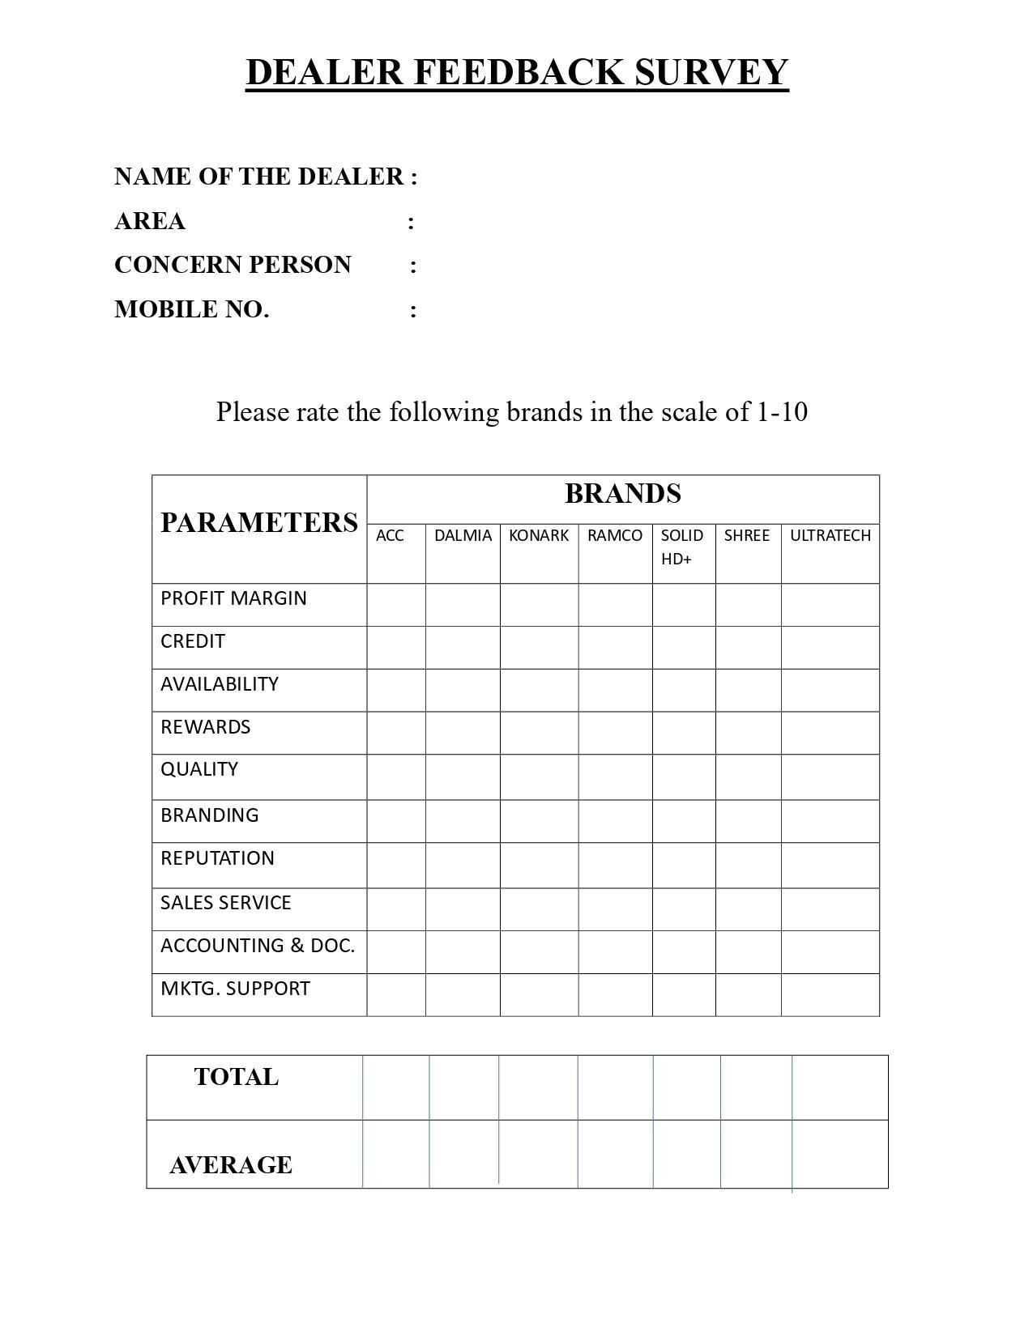

Slide 7

FINDINGS
➢Ultra Tech have succesful distribution channel and other companies are still struggling to keep strong distribution channelto deliver products in each location.
➢Most of the dealers have 6 to 10 years of experience in dealership among that they are dealing with Solid HD cements above 10 years
➢Most of the dealer rated that the quality of Solid HD is very good
➢Most of the dealers are also dealing with the other brands to satisfy the need of various customers.
➢According to the retailers outdoor advertisement and electronic media are consider to be more effective to promote Solid HD cements.
➢Overall, 60% above dealers rated Solid HD cements as Good one in the current market.

Slide 8

RECOMMENDATIONS
➢Reach to the rural area market need to be strengthened.
➢More Transportation facility & Incentives need to be provided to the retailers for strengthened the brand for better performance in market.
➢On interviewing dealers the most important thing they said about the price flexibility, they want the company should give price flexibility to play in the market.

Slide 9

CONCLUSION
Setting the right prices and employing effective marketing strategies are pivotal for business success. Our market research in Bhubaneswar emphasizes SOLID HD cement's strength due to superior quality and robust marketing. With customers satisfied and a competitive edge in a crowded market, SOLID HD cement benefits from effective branding and a well-established distribution network, showcasing the significant impact of strategic marketing efforts."

Slide 10


